Slide 1
SAMPLING
METHODS
Dhanasekaran N

Slide 2
Populations vs. Samples
Who = Population:
  all individuals of interest
  US Voters, Dentists, College students, Children
What = Parameter
  Characteristic of population
Problem: can’t study/survey whole pop
Solution: Use a sample for the “who”
  subset, selected from population
  calculate a statistic for the “what”
Notes:
Sampling makes research possible
Samples should be representative of the population – characteristics of the sample participants accurately reflect the characteristics of the population.

Slide 3
Types of Sampling
Simple Random Sampling
Stratified Random Sampling
Cluster Sampling
Systematic Sampling
Representative Sampling (Can be stratified random or quota sampling)
Convenience or Haphazard Sampling
Sampling with Replacement vs. Sampling without Replacement

Slide 4
Types of Statistics
Descriptive statistics:
  Organize and summarize scores from samples
Inferential statistics:
  Infer information about the population based on what we know from sample data
  Decide if an experimental manipulation has had an effect
Notes:
Descriptive stats are procedures used for organizing and summarizing scores in a sample so that we can describe or communicate about variables of interest.
Note: applies only to the sample (says nothing about how accurately the data may reflect what goes on in the population).
E.g. – mean (average), mode, median, frequency distribution
Use sample statistics to “infer” something about relationships in the entire population. Assumes sample is representative of population.
Procedures designed to test whether we would be likely to find the same results with another sample drawn from the same population – in fact, mathematically tests whether the sample results would be obtained if all possible samples from the population were tested. Also, attempts to rule out chance as an explanation for the results - that results reflect real relationships that exist in the population and aren’t random or “lucky”. (We’ll get to this at the end of the semester and next semester).
But before you can describe or evaluate a relationship using statistics, you need to design your study so that your research question can be addressed. This is where research design and methodology come in.

Slide 5
THE BIG PICTURE OF STATISTICS
Theory
Question to answer / Hypothesis to test
Design Research Study
Collect Data
(measurements, observations)
Organize and make sense of the #s
USING STATISTICS!
Depends on our goal:
Describe characteristics Test hypothesis, Make conclusions,
organize, summarize, condense data interpret data, understand relations
DESCRIPTIVE STATISTICS INFERENTIAL STATISTICS

Slide 6
Types of Variables
Quantitative
  Measured in amounts
  Ht, Wt, Test score
Discrete:
  separate categories
  Letter grade
Qualitative
  Measured in categories
  Gender, race, diagnosis
Continuous:
  infinite values in between
  GPA
Notes:
Can be quantitative (measured in amounts)
e.g., height, weight, test score, ratings.
Or qualitative (categorical)
e.g., gender, race, diagnosis.

Slide 7
Scales of Measurement
Nominal Scale: Categories, labels, data carry no numerical value
Ordinal Scale: Rank ordered data, but no information about distance between ranks
Interval Scale: Degree of distance between scores can be assessed with standard sized intervals
Ratio Scale: Same as interval scale with an absolute zero point.

Slide 8
SAMPLING
A sample is “a smaller (but hopefully representative) collection of units from a population used to determine truths about that population” (Field, 2005)
Why sample?
  Resources (time, money) and workload
  Gives results with known accuracy that can be calculated mathematically
The sampling frame is the list from which the potential respondents are drawn
  Registrar’s office
  Class rosters
  Must assess sampling frame errors
Notes:
Sampling frame errors: university versus personal email addresses; changing class rosters; are all students in your population of interest represented?

Slide 9
SAMPLING……
What is your population of interest?
    To whom do you want to generalize your results?
      All doctors
      School children
      Indians
      Women aged 15-45 years
      Other
Can you sample the entire population?
Notes:
How do we determine our population of interest?
Administrators can tell us
We notice anecdotally or through qualitative research that a particular subgroup of students is experiencing higher risk
We decide to do everyone and go from there
3 factors that influence sample representativeness
Sampling procedure
Sample size
Participation (response)
When might you sample the entire population?
When your population is very small
When you have extensive resources
When you don’t expect a very high response

Slide 10
SAMPLING…….
3 factors that influence sample representative-ness
    Sampling procedure
    Sample size
    Participation (response)
When might you sample the entire population?
    When your population is very small
    When you have extensive resources
    When you don’t expect a very high response

Slide 11
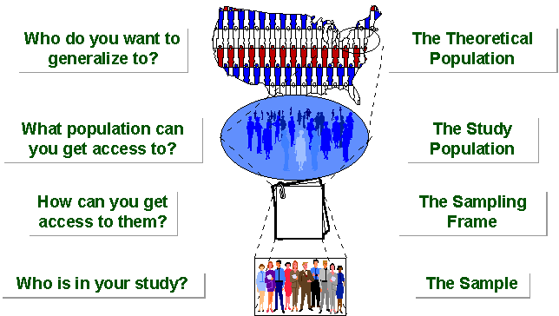
SAMPLING BREAKDOWN
Notes:
Picture of sampling breakdown

Slide 12
SAMPLING…….
STUDY POPULATION
SAMPLE
TARGET POPULATION

Slide 13
Types of Samples
Probability (Random) Samples
Simple random sample
  Systematic random sample
  Stratified random sample
  Multistage sample
  Multiphase sample
  Cluster sample
Non-Probability Samples
  Convenience sample
  Purposive sample
  Quota
Notes:
Two general approaches to sampling are used in social science research. With probability sampling, all elements (e.g., persons, households) in the population have some opportunity of being included in the sample, and the mathematical probability that any one of them will be selected can be calculated. With nonprobability sampling, in contrast, population elements are selected on the basis of their availability (e.g., because they volunteered) or because of the researcher's personal judgment that they are representative. The consequence is that an unknown portion of the population is excluded (e.g., those who did not volunteer). One of the most common types of nonprobability sample is called a convenience sample – not because such samples are necessarily easy to recruit, but because the researcher uses whatever individuals are available rather than selecting from the entire population.
Because some members of the population have no chance of being sampled, the extent to which a convenience sample – regardless of its size – actually represents the entire population cannot be known

Slide 14
SIMPLE RANDOM SAMPLING
Applicable when population is small, homogeneous & readily available
All subsets of the frame are given an equal probability. Each element of the frame thus has an equal probability of selection.
It provides for greatest number of possible samples. This is done by assigning a number to each unit in the sampling frame.
A table of random number or lottery system is used to determine which units are to be selected.

Slide 15
SIMPLE RANDOM SAMPLING….
Estimates are easy to calculate.
Simple random sampling is always an EPS design, but not all EPS designs are simple random sampling.
Disadvantages
If sampling frame large, this method impracticable.
Minority subgroups of interest in population may not be present in sample in sufficient numbers for study.

Slide 16
SYSTEMATIC SAMPLING
Systematic sampling relies on arranging the target population according to some ordering scheme and then selecting elements at regular intervals through that ordered list.
Systematic sampling involves a random start and then proceeds with the selection of every kth element from then onwards. In this case, k=(population size/sample size).
It is important that the starting point is not automatically the first in the list, but is instead randomly chosen from within the first to the kth element in the list.
A simple example would be to select every 10th name from the telephone directory (an 'every 10th' sample, also referred to as 'sampling with a skip of 10').

Slide 17
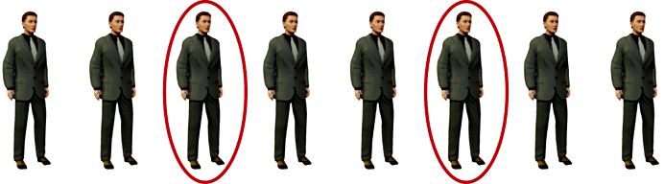
SYSTEMATIC SAMPLING……
As described above, systematic sampling is an EPS method, because all elements have the same probability of selection (in the example given, one in ten). It is not 'simple random sampling' because different subsets of the same size have different selection probabilities - e.g. the set {4,14,24,...,994} has a one-in-ten probability of selection, but the set {4,13,24,34,...} has zero probability of selection.

Slide 18
SYSTEMATIC SAMPLING……
ADVANTAGES:
Sample easy to select
Suitable sampling frame can be identified easily
Sample evenly spread over entire reference population
DISADVANTAGES:
Sample may be biased if hidden periodicity in population coincides with that of selection.
Difficult to assess precision of estimate from one survey.

Slide 19
STRATIFIED SAMPLING
Where population embraces a number of distinct categories, the frame can be organized into separate "strata." Each stratum is then sampled as an independent sub-population, out of which individual elements can be randomly selected.
Every unit in a stratum has same chance of being selected.
Using same sampling fraction for all strata ensures proportionate representation in the sample.
Adequate representation of minority subgroups of interest can be ensured by stratification & varying sampling fraction between strata as required.

Slide 20
STRATIFIED SAMPLING……
Finally, since each stratum is treated as an independent population, different sampling approaches can be applied to different strata.
Drawbacks to using stratified sampling.
First, sampling frame of entire population has to be prepared separately for each stratum
Second, when examining multiple criteria, stratifying variables may be related to some, but not to others, further complicating the design, and potentially reducing the utility of the strata.
Finally, in some cases (such as designs with a large number of strata, or those with a specified minimum sample size per group), stratified sampling can potentially require a larger sample than would other methods

Slide 21
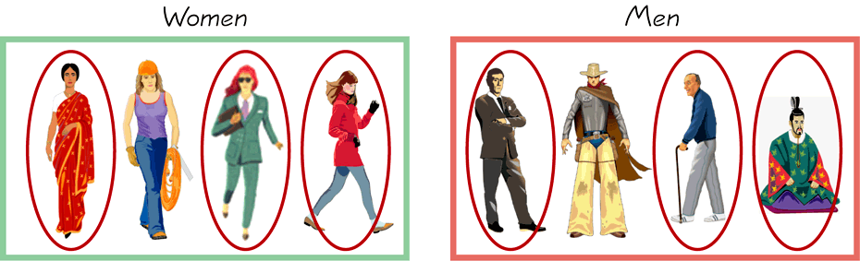
STRATIFIED SAMPLING…….
        Draw a sample from each stratum

Slide 22
CLUSTER SAMPLING
Cluster sampling is an example of 'two-stage sampling' .
First stage a sample of areas is chosen;
Second stage a sample of respondents within those areas is selected.
Population divided into clusters of homogeneous units, usually based on geographical contiguity.
Sampling units are groups rather than individuals.
A sample of such clusters is then selected.
All units from the selected clusters are studied.

Slide 23
CLUSTER SAMPLING…….
Advantages :
Cuts down on the cost of preparing a sampling frame.
This can reduce travel and other administrative costs.
Disadvantages: sampling error is higher for a simple random sample of same size.
Often used to evaluate vaccination coverage in EPI

Slide 24
CLUSTER SAMPLING…….
Identification of clusters
  List all cities, towns, villages & wards of cities with their population falling in target area under study.
  Calculate cumulative population & divide by 30, this gives sampling interval.
  Select a random no. less than or equal to sampling interval having same no. of digits. This forms 1st cluster.
  Random no.+ sampling interval = population of 2nd cluster.
  Second cluster + sampling interval = 4th cluster.
  Last or 30th cluster = 29th cluster + sampling interval

Slide 25
CLUSTER SAMPLING…….
Two types of cluster sampling methods.
One-stage sampling. All of the elements within selected clusters are included in the sample.
Two-stage sampling. A subset of elements within selected clusters are randomly selected for inclusion in the sample.

Slide 26
CLUSTER SAMPLING…….
Freq c f cluster
I 2000 2000 1
II 3000 5000 2
III 1500 6500
IV 4000 10500 3
V 5000 15500 4, 5
VI 2500 18000 6
VII 2000 20000 7
VIII 3000 23000 8
IX 3500 26500 9
X 4500 31000 10
XI 4000 35000 11, 12
XII 4000 39000 13
XIII 3500 44000 14,15
XIV 2000 46000
XV 3000 49000 16
XVI 3500 52500 17
XVII 4000 56500 18,19
XVIII 4500 61000 20
XIX 4000 65000 21,22
XX 4000 69000 23
XXI 2000 71000 24
XXII 2000 73000
XXIII 3000 76000 25
XXIV 3000 79000 26
XXV 5000 84000 27,28
XXVI 2000 86000 29
XXVII 1000 87000
XXVIII 1000 88000
XXIX 1000 89000 30
XXX 1000 90000
90000/30 = 3000 sampling interval

Slide 27
Difference Between Strata and Clusters
Although strata and clusters are both non-overlapping subsets of the population, they differ in several ways.
All strata are represented in the sample; but only a subset of clusters are in the sample.
With stratified sampling, the best survey results occur when elements within strata are internally homogeneous. However, with cluster sampling, the best results occur when elements within clusters are internally heterogeneous

Slide 28
CONVENIENCE SAMPLING
Sometimes known as grab or opportunity sampling or accidental or haphazard sampling.
A type of nonprobability sampling which involves the sample being drawn from that part of the population which is close to hand. That is, readily available and convenient.
The researcher using such a sample cannot scientifically make generalizations about the total population from this sample because it would not be representative enough.
For example, if the interviewer was to conduct a survey at a shopping center early in the morning on a given day, the people that he/she could interview would be limited to those given there at that given time, which would not represent the views of other members of society in such an area, if the survey was to be conducted at different times of day and several times per week.
This type of sampling is most useful for pilot testing.
In social science research, snowball sampling is a similar technique, where existing study subjects are used to recruit more subjects into the sample.

Slide 29
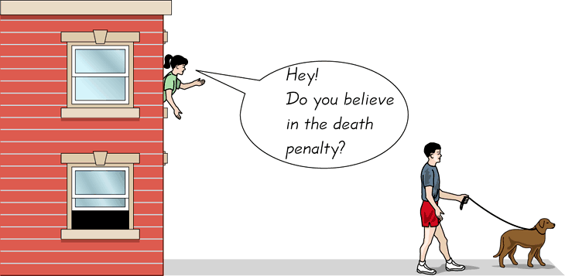
CONVENIENCE SAMPLING…….
  Use results that are easy to get

Slide 30
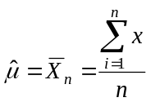
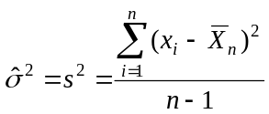
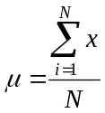
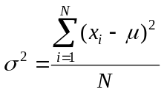
Statistical Inference
The process of making guesses about the truth from a sample.
Sample statistics
Truth (not observable)
Sample (observation)
*hat notation ^ is often used to indicate “estimate”
Population parameters
Make guesses about the whole population

Slide 31
Thank You…..!!!!!
Any Questions ?????

